Slide 1
CS1231 Tutorial 3
AY18/19 – WEEK 4
Andrew Tan

Slide 2
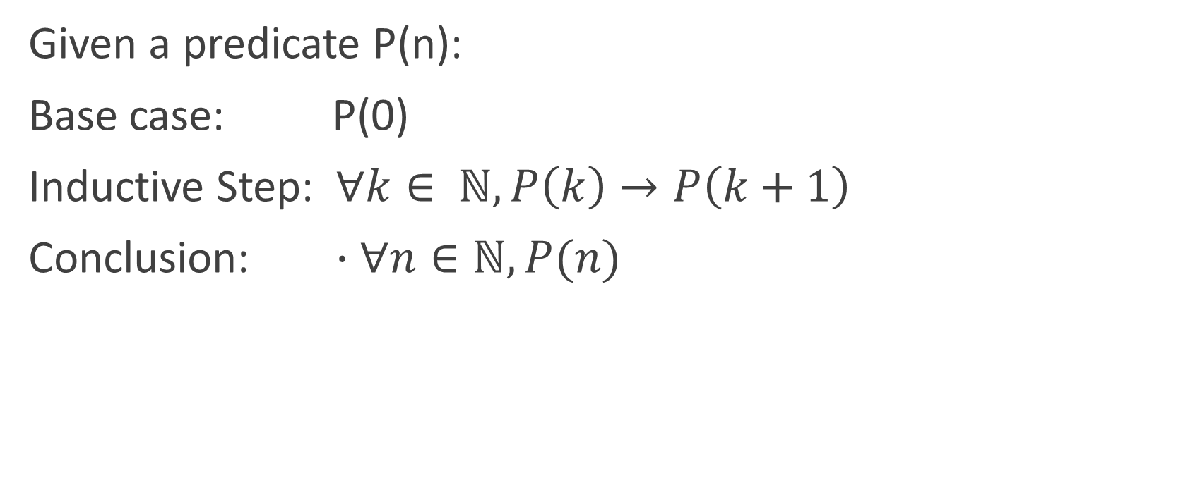
Mathematical Induction
Given a predicate P(n):
Base case: P(0)
Inductive Step: $∀k∈ ℕ, P\left(k\right)→P\left(k+1\right)$
Conclusion: $∙∀n∈ℕ, P(n)$

Slide 3
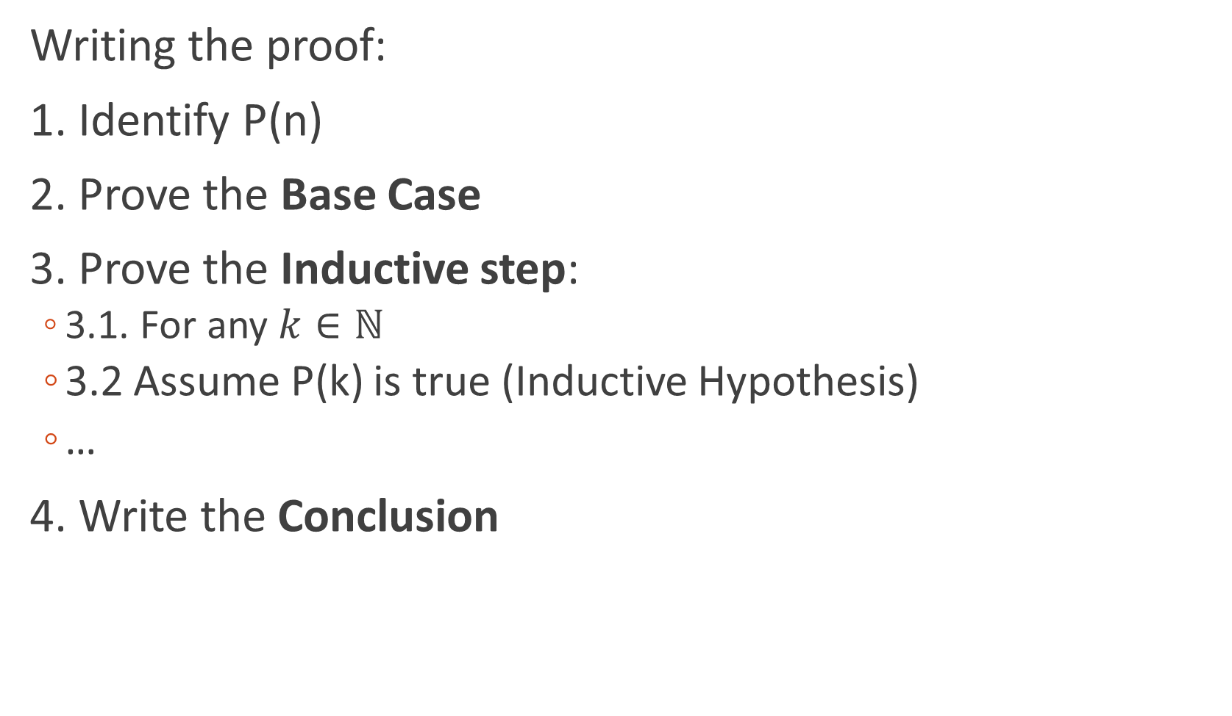
Mathematical Induction
Writing the proof:
1. Identify P(n)
2. Prove the Base Case
3. Prove the Inductive step:
3.1. For any $k∈ℕ$
3.2 Assume P(k) is true (Inductive Hypothesis)
…
4. Write the Conclusion

Slide 4
Strong Induction
Inductive hypothesis:
Assume P(k), P(k-1), …, P(a) are all true.
All other steps are similar to regular induction

Slide 5
Number Theory
The branch of mathematics that deals with the properties and relationships of numbers, especially the positive integers.

Slide 6
Number Theory
Primes are fun!
Fundamental Theorem of Arithmetic:
All positive integers greater than 1 can be uniquely factorized into a product of prime numbers

Slide 7

Number Theory
Show that $2^{\frac{1}{n}}$ is irrational for any $n≥2$

Slide 8
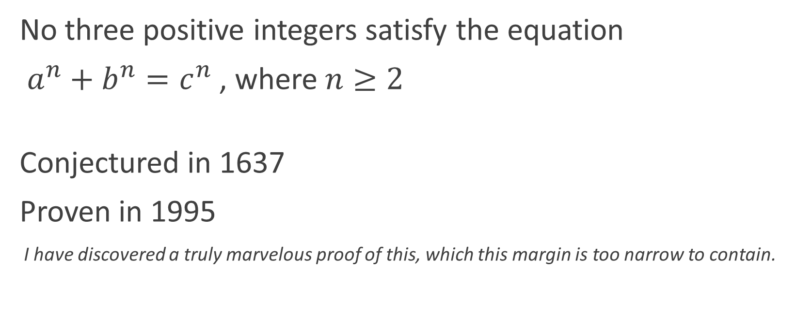
Fermat’s Last Theorem
No three positive integers satisfy the equation
$a^{n}+b^{n}=c^{n}$ , where $n≥2$
Conjectured in 1637
Proven in 1995
I have discovered a truly marvelous proof of this, which this margin is too narrow to contain.

